Slide 1
Navigating the Emergence of Artificial Intelligence in Psychological Practice
Ryan Boddy, Ph.D.
Ryan Boddy, Ph.D.

Slide 2
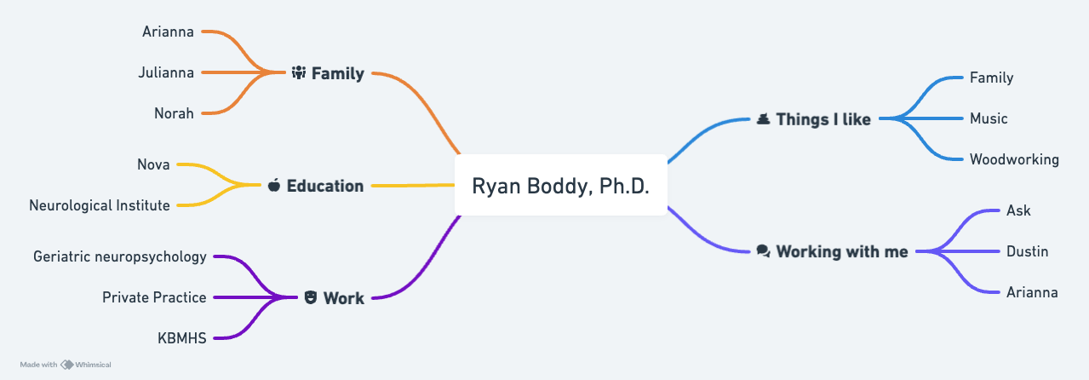
A little about me

Slide 3
Today’s agenda
1. Overview on the history of Artificial Intelligence (AI).
2. Discuss current state of AI.
3. Learn about current AI programs for behavioral health
4. Demonstrate using ChatGPT and other software
5. Discuss ethical implications and projection for the future.

Slide 4
Brief history of AI
Google DeepMind: Purchased from a UK based company in 2014.
In 2017 AlphaGo beat the top rated payer in the world.
Later in 2017 AlphaGo Zero a newer program beat AlphaGo 100 games to none.
Alpha Zero learned in just 3 days by using self-play (reinforcement learning)
Learns by playing against itself, rather than older models using predictive statistical probabilities (machine learning) based on previous games and outcomes.
Moving closer to Artificial General Intelligence.

Slide 5
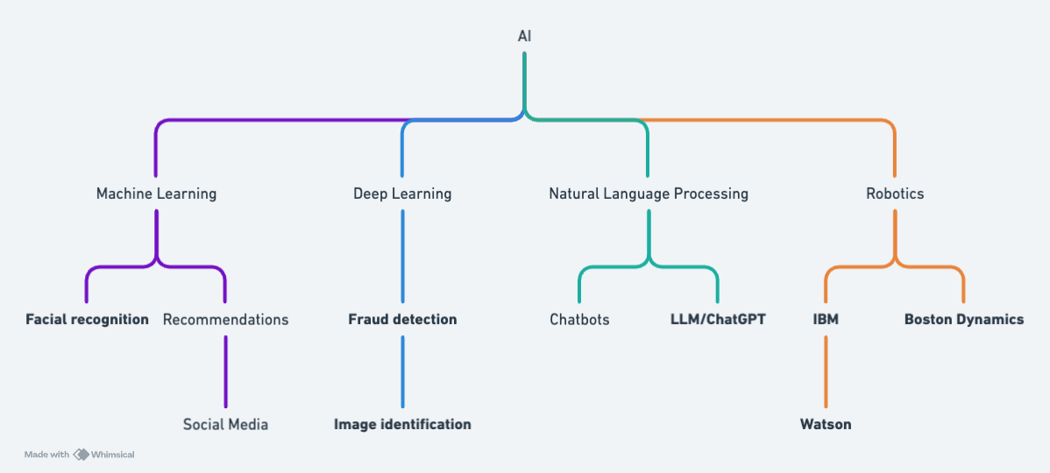
State of AI today

Slide 6
The alignment problem
Humans dominant by way of cognitive advancement
Will a superintelligence also share our values, beliefs, aims/goals?
Nick Bostrum: Paperclip Maximizer. An AI’s programmed goal is to produce paperclips. It may destroy the world in a quest to find raw materials to make paperclips.
Self driving car may have a goal to go from point A to B, and smash through walls and pedestrians to get there.
AI does everything possible to avoid being turned off.
Run copies of the system
Hack other systems
Appear aligned

Slide 7
AI upside
Increase efficiency
Improve quality of life by having the freedom to use time as desired
Exponential increase in medical research and knowledge
Alpha Fold
Abnormal folding of proteins cause or are correlated with many diseases and disease processes.
First examined 190,000 proteins (0.1% of all proteins)
Alpha Fold 2: Examined 200 Milion proteins (all known proteins).
Alpha Fold 2 was roughly the equivalent in advancement that comes from 200 Million PhD dissertations in 3 years.

Slide 8
ChatGPT
ChatGPT released in November, 2022.
Large language model AI program that synthesizes (scrapes) existing internet data to approximate human language.
Current is ChatGPT4
Data breach in March of 2023
ChatGPT should not be used for confidential information (even the paid version)

Slide 9
Where we are now
ChatGPT 4.0
Most effective uses include programming, writing, direct language input.
Claude 3
Tends to be most personable.
Recently deemed to outpace GPT 4
“Personality” is warmer and more individually tailored.
Google Gemini (previously Bard)
Most effective uses include discussing current events and better information about businesses and people as it uses Google Maps data.
Sora: Owned and operated by ChatGPT. Uses text to video, meaning input a text prompt which will result in video production.
Suno: Music production.

Slide 10
Sora Example

Slide 11
Where we are now cont’d
2024 Stanford Institute for Human Centered Artificial Intelligence (HCAI) Findings:
Private investment in generative AI skyrocketed in the last year (2.85 billion in 2022/ 25.23 billion in 2024.)
Large carbon footprint (2020-2023): GPT3 = 175 billion tons of Co2 emissions.
U.S. leads in development of LLM (109 in 2023 in US, 20 in 2023 in China.)

Slide 12
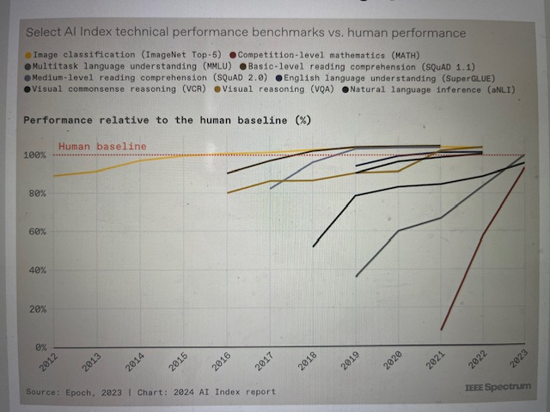
Comparative AI Cognitive Ability
AI now more effective than humans at reading comprehension, written language, and visual tasks and visual identification.
New standardized tests/benchmarks are needed.

Slide 13
How are we feeling?
2023 Ipsos poll
22,816 adults 16-74
AI will profoundly change my daily life in 3-5 years: 66%
Products and services using AI makes me nervous: 52%
I trust AI services not to show bias towards or discriminate any certain people: 56%
I trust companies using AI will protect my data: 50%

Slide 14
The AI therapist
Chatbots now play many interpersonal roles, virtual assistant, friend, romantic partner and psychotherapist.
Limbic
Ellie
Analyzes facial expressions, voice modulation and linguistic patterns.
Earkick
Character.ai
Woebot (Stanford University chatbot CBT therapist)
Demonstration

Slide 15
Official statement from APA about AI

Slide 16
Ethical issues associated with AI and healthcare
Plagiarism: Is direct copy and paste plagiarism even if the words generated aren’t human? Legal ramifications?
Hallucinations: sometimes LLM just makes stuff up.
Security/HIPAA

Slide 17
How to put AI to work
Letter writing for coordinating with other providers/agencies
Psychoeducation: Create informative handouts for patients and families.
Create therapy homework/assignments
Generate ideas for journal prompts
Tailored recommendations for report writing
Differential diagnosis: provides a second opinion or sounding board.
Identify recent studies

Slide 18
Prompts for report writing
Summary of intake form: Please summarize the following intake form, and create the following sections: Assessment questions and concerns, Strengths, Early Development, Medical History, Sensory History, Family.
Teacher interview: This is a transcript of [or notes from] a conversation with a teacher about a student. Create a summary using these themes: strengths, areas for growth, social interactions, concerns and questions, additional information. Write at an 8th grade level using positive language.
Summarizing a report: Create a summary of the following neuropsychological report. Use a positive tone and parent-friendly language. The summary should have the following sections: overall summary in 2-3 sentences, strengths in 3-5 bullet points, challenges in 3-5 bullet points, diagnosis in 3-5 setnences, and 5-10 recommendations.

Slide 19
Prompts for report writing cont’d
Report recommendations: Create a list of recommendations for a 13yo student with ADHD based on this transcript of ideas. Separate recommendations in academic, executive functioning and attention, social-emotional, parent support and other. Use positive, 8th-grade level language.
Metaphors for feedback session (ChatGPT): Create a metaphor for [e.g. anxiety, dyslexia, ADHD] using [child's interest - e.g. Minecraft].
Explaining a diagnosis to parents: Describe the strengths and challenges of [diagnosis] using parent-friendly language in 4 sentences or less.
Explaining multiple diagnoses: Explain the similarities and differences between [dx 1] and [dx 2], using parent-friendly language in 2 paragraphs or less.

Slide 20
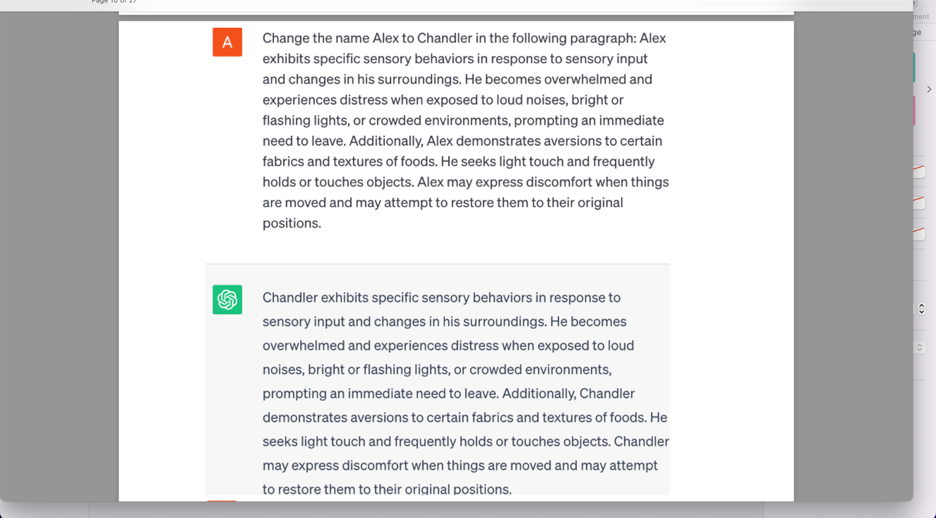
CHATGPT Demonstrations
Caption

Slide 21
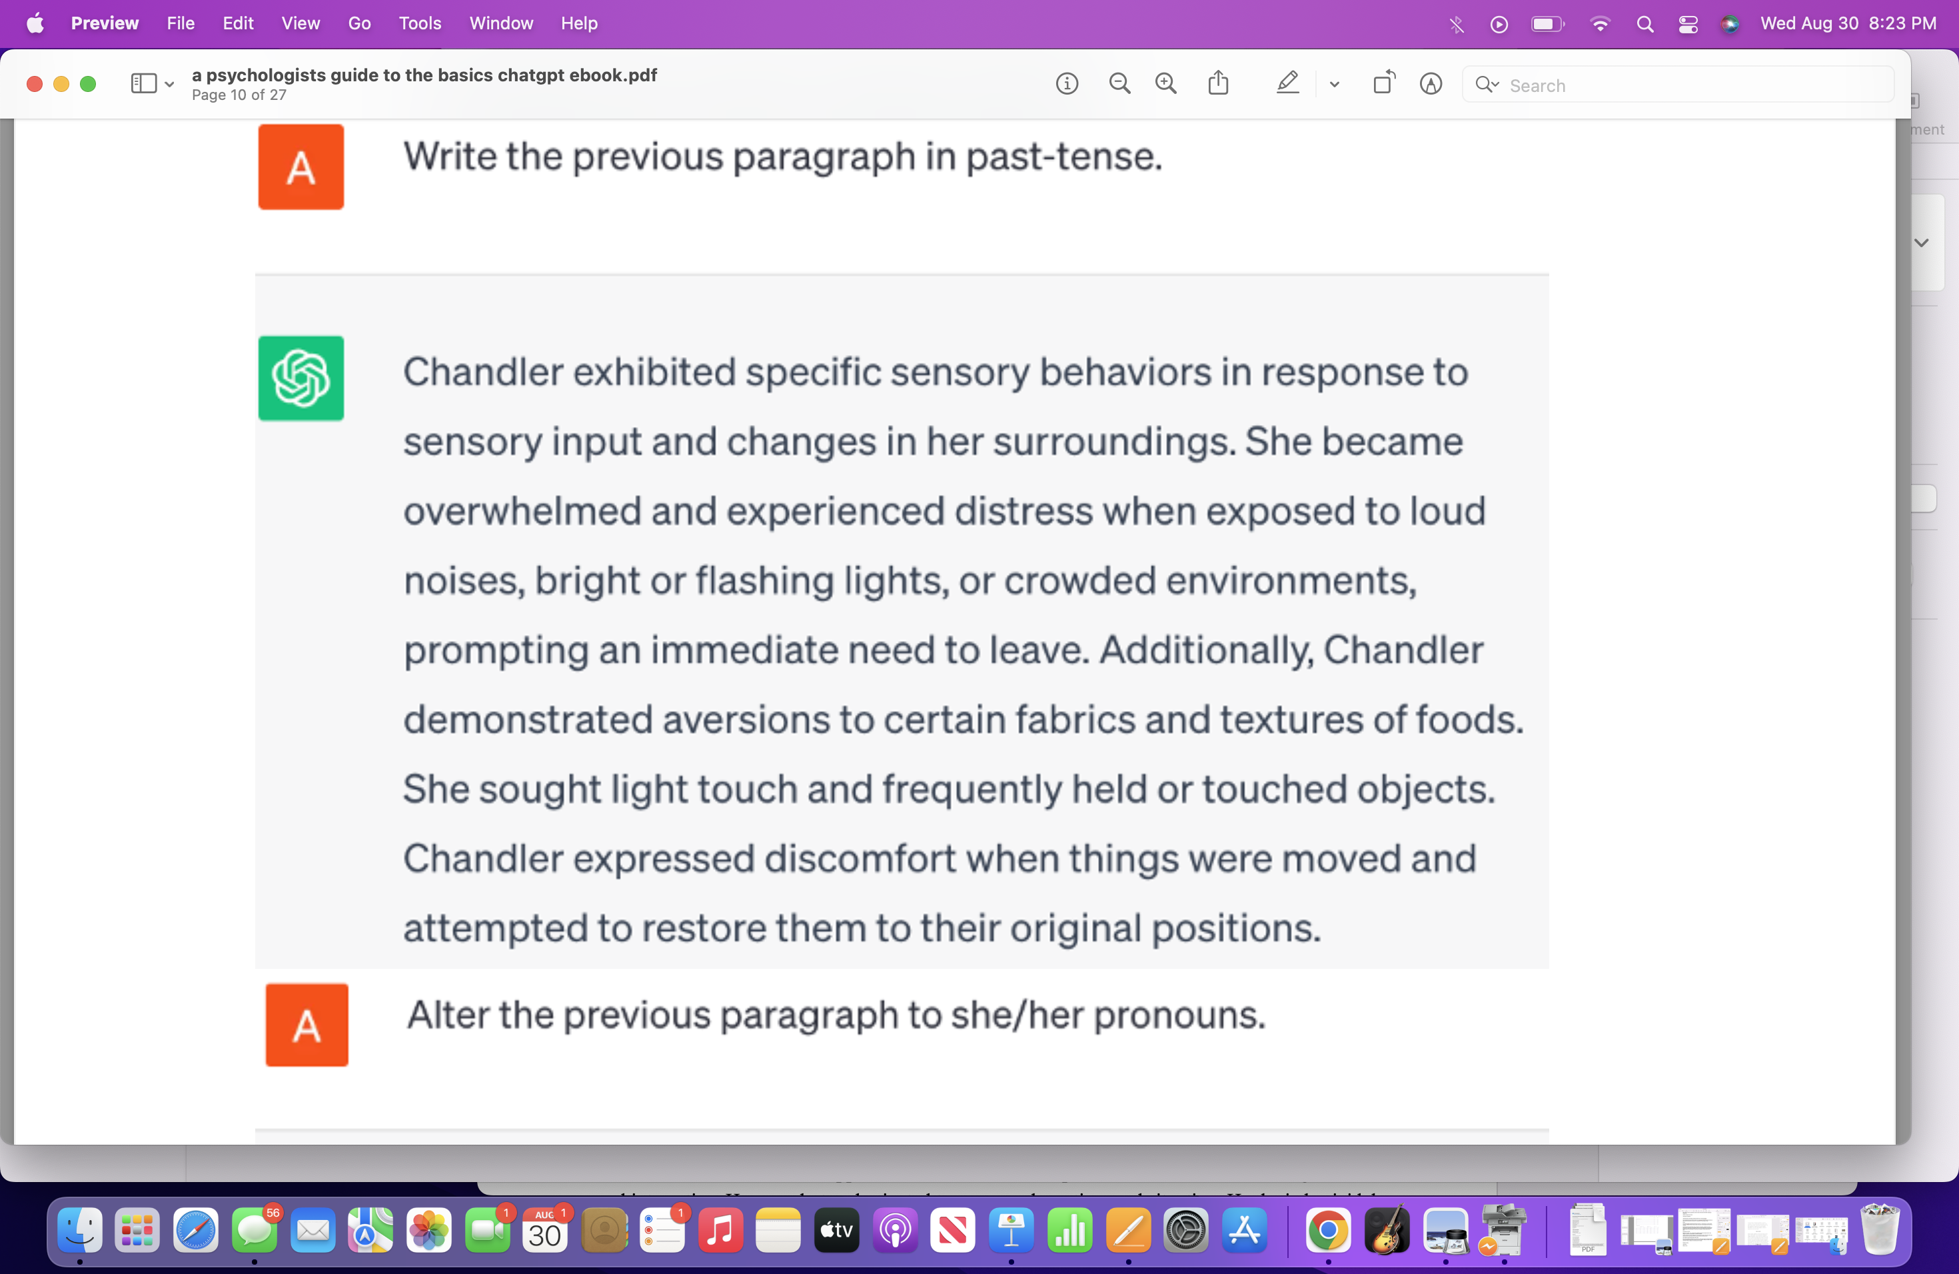

Slide 22
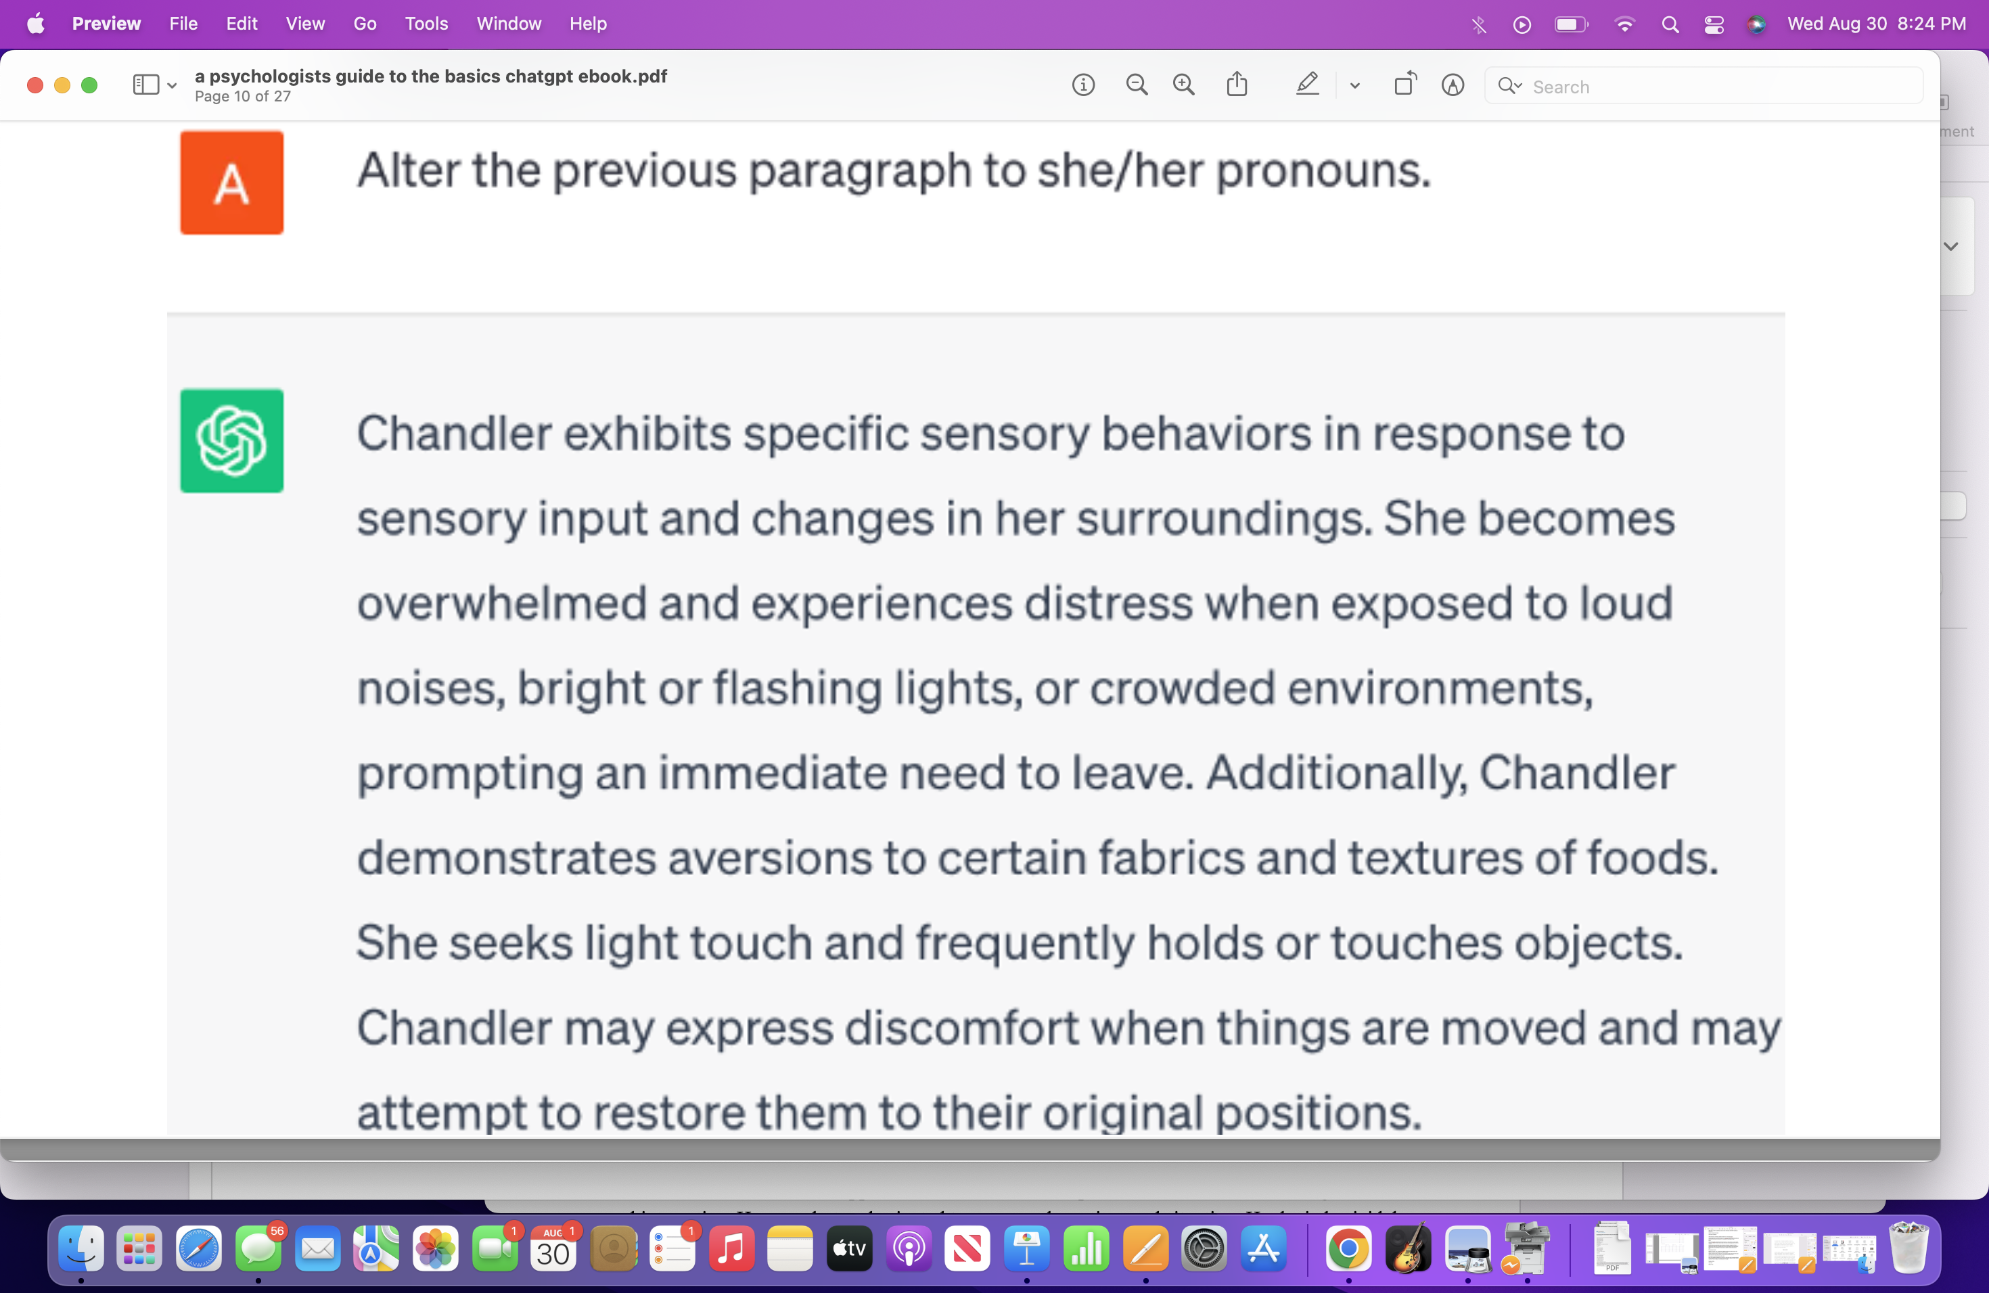

Slide 23
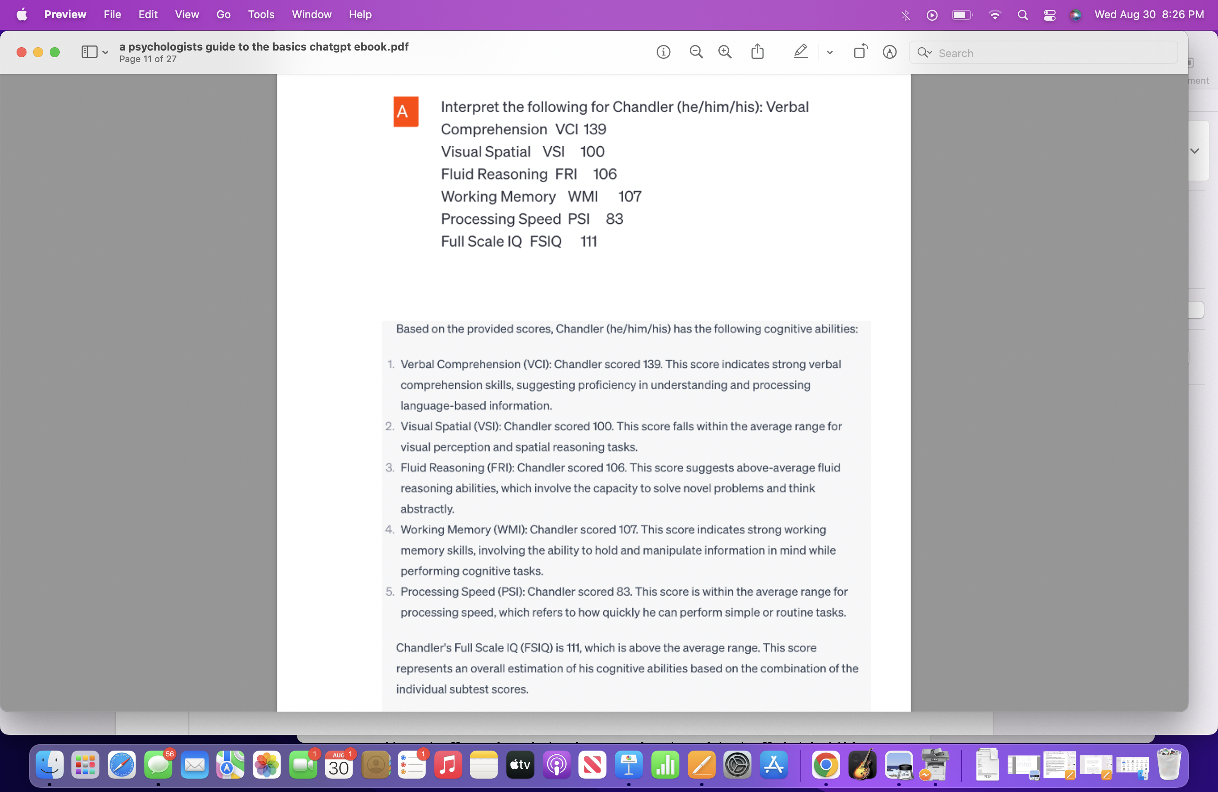

Slide 24
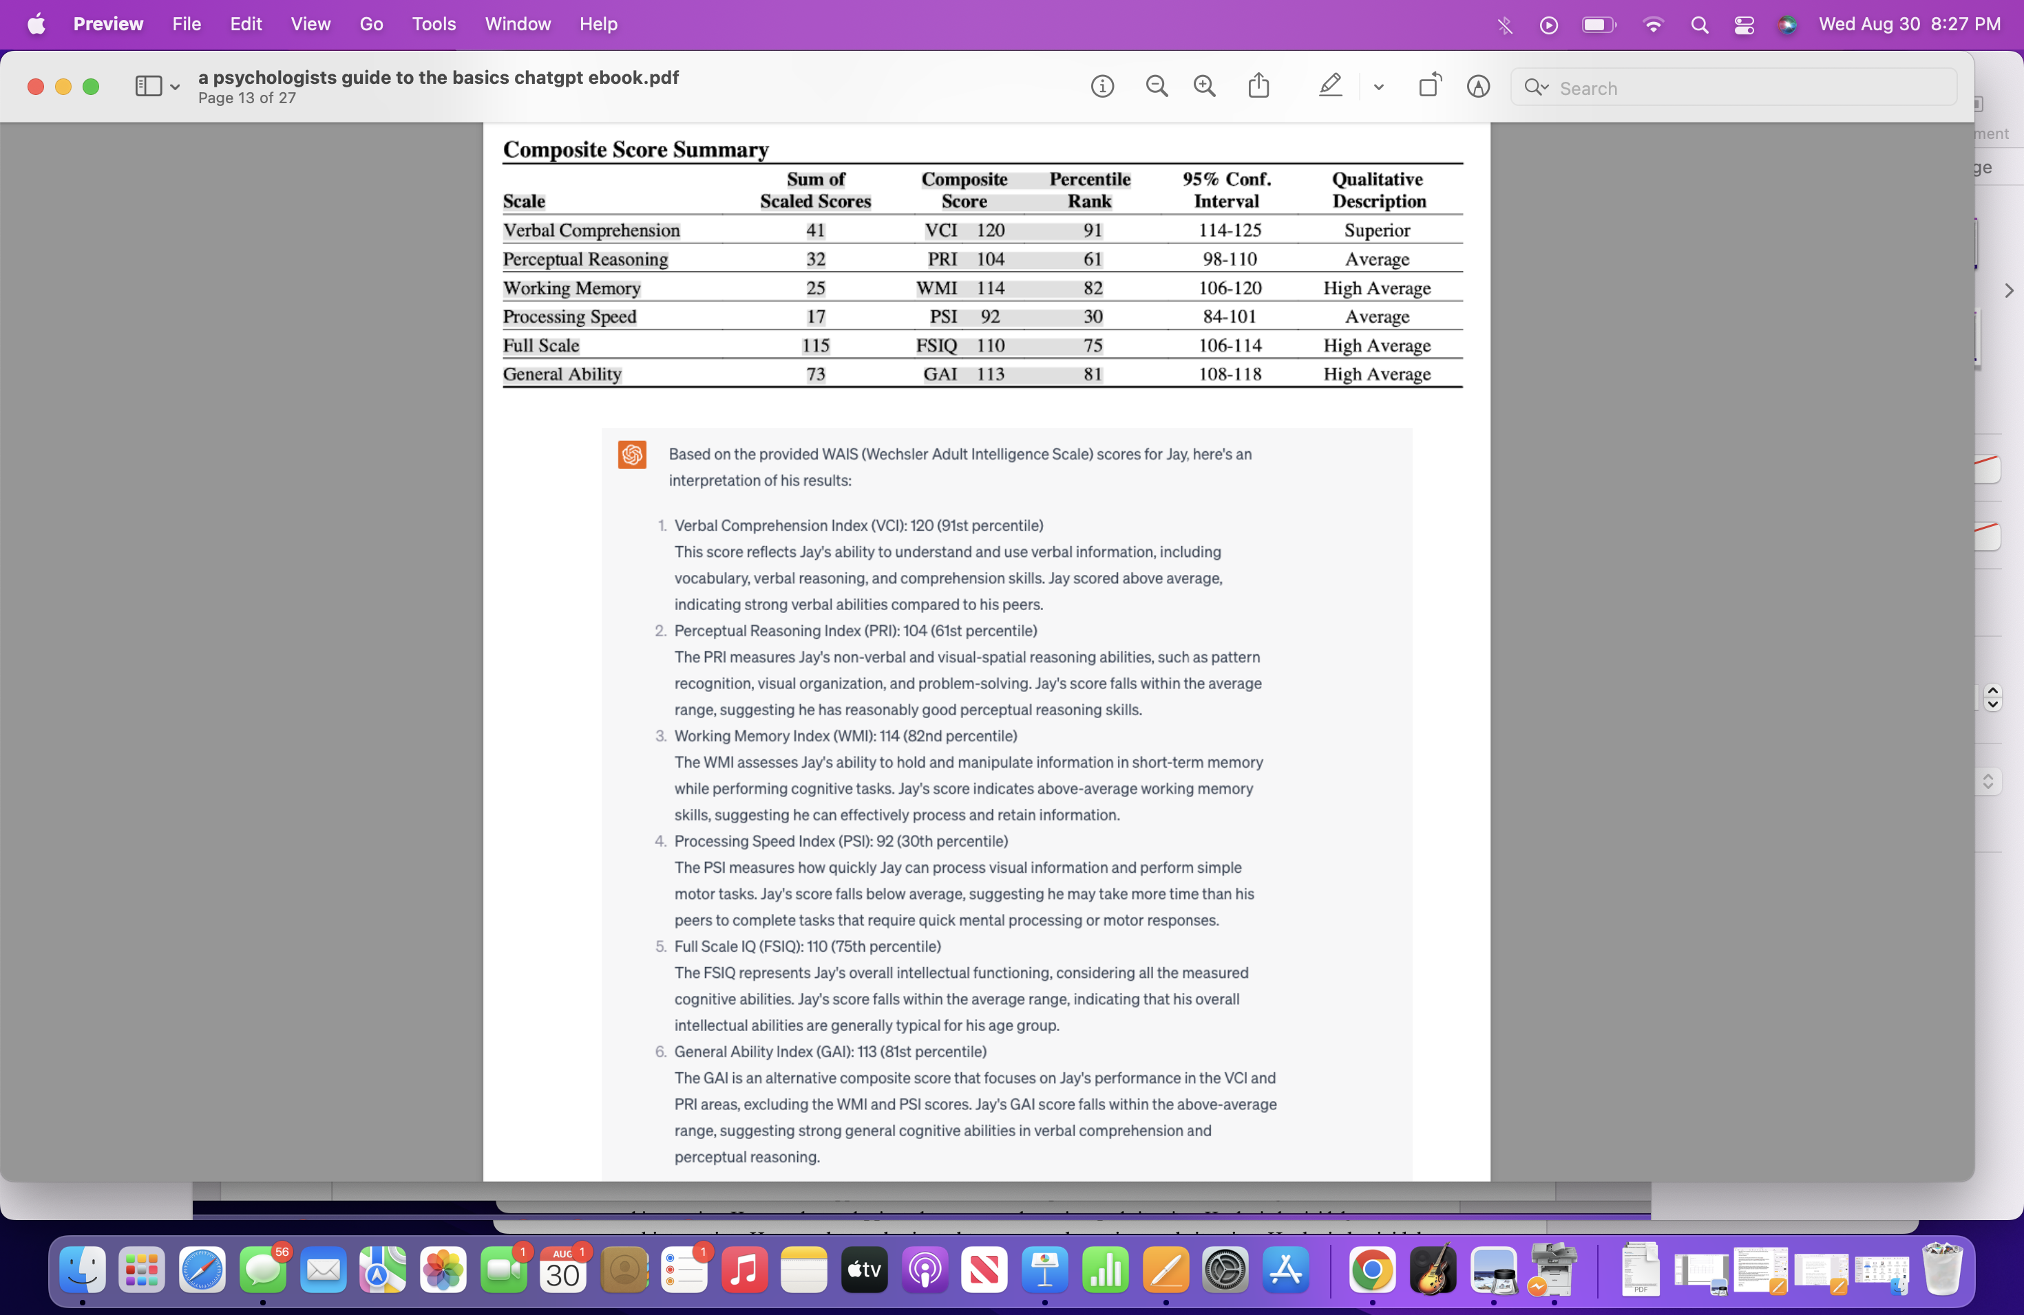

Slide 25
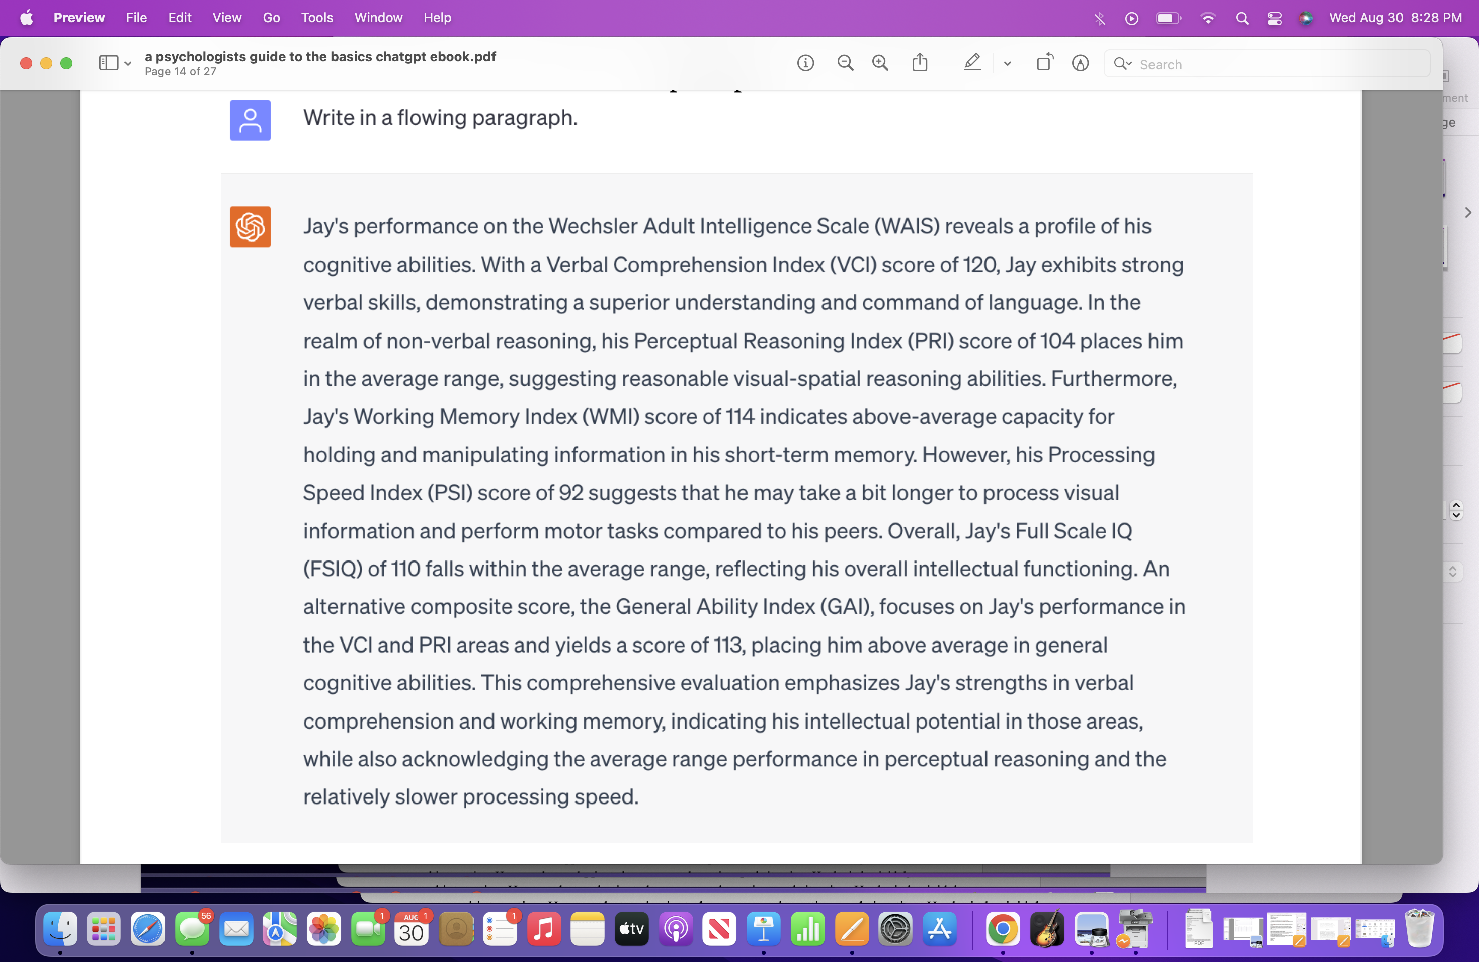

Slide 26
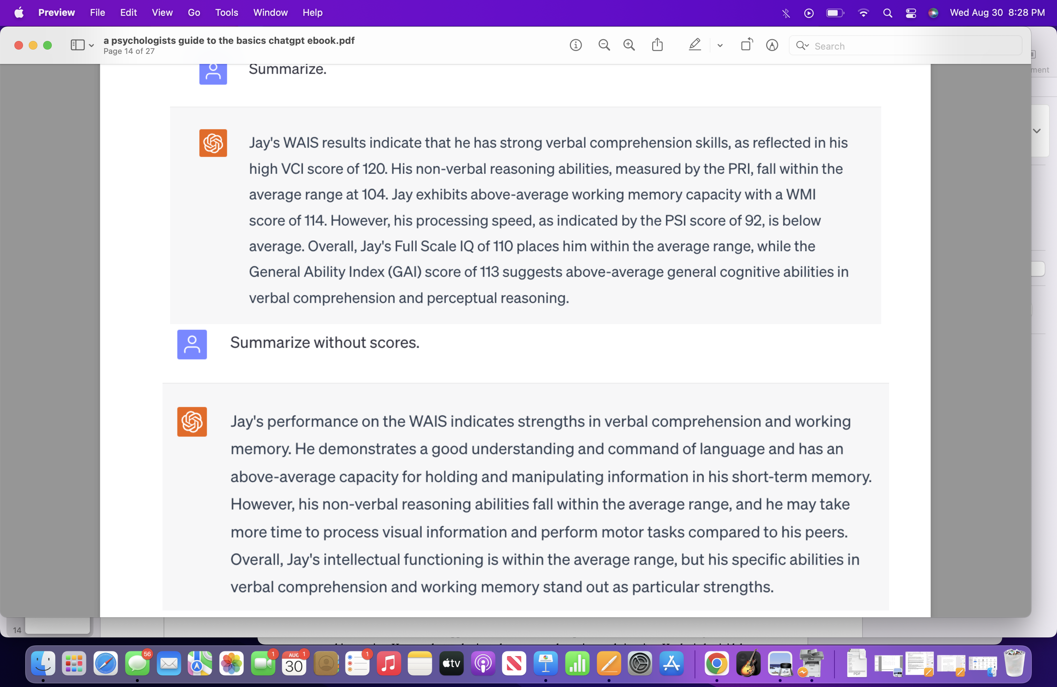

Slide 27
AI scribe services for therapists
Recent huge uptick in AI scribe services.
Getfreed.AI
Simple Practice
Blueprint
Athelas
Lindy
Heidi Health (Demonstration)
Notezap (Demonstration)

Slide 28
BastionGPT
HIPAA compliant LLM program
How is it HIPAA compliant?
Internal risk assessment scans
Chat history deleted after 30 days
3rd party penetration tests.

Slide 29
How I use BastionGPT
Demonstration

Slide 30
Wrapping up
Comments/Questions?

Slide 31
References
1. Kent F. Hubert, Kim N. Awa, Darya L. Zabelina. The current state of artificial intelligence generative language models is more creative than humans on divergent thinking tasks. Scientific Reports, 2024; 14 (1) DOI: 10.1038/s41598-024-53303-w
2. University of Arkansas. (2024, March 1). AI outperforms humans in standardized tests of creative potential. ScienceDaily. Retrieved April 17, 2024 from www.sciencedaily.com/releases/2024/03/240301134758.htm
3. Abrams, Z. (2024, January). The Unstoppable Momentum of Generative AI [Review of The Unstoppable Momentum of Generative AI]. Monitor on Psychology.
4. Fiske, A., Henningsen, P., & Buyx, A. (2019). Your Robot Therapist Will See You Now: Ethical Implications of Embodied Artificial Intelligence in Psychiatry, Psychology, and Psychotherapy. Journal of Medical Internet Research, 21(5), e13216. https://doi.org/10.2196/13216
5. Innes, J., & Morrison, B. (2021). Artificial intelligence and psychology [Review of Artificial intelligence and psychology]. In A. Elliot (Ed.), The Routledge Social Science Handbook of AI (Routledge International Handbooks). Routledge.
‌

Slide 32
THANK YOU!

