Slide 1
Helping Long Covid Survivors Move From Surviving to Thriving
James C Jackson PsyD
Research Professor of Medicine
Director of Behavioral Health ICU Recovery Center
Vanderbilt University, Nashville, TN

Slide 2
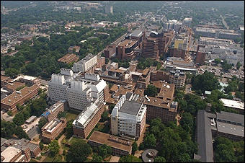
Disclosures: I have no conflicts to disclose.

Slide 3
Long Covid – A Definition
“Persistent signs, symptoms, and conditions that continue or develop after initial COVID-19 or SARS-CoV-2 infection.”
Can occur even after a mild or very mild infection.
Can be mild or severe.
Can be a nuisance – “like a stone in your shoe” or can be profoundly disruptive.
Can vary widely with regard to their nature – primarily cognitive, physical, or mental health related.

Slide 4
Long Covid - Prevalence
Varies widely depending on the case definition used.
Worldwide, as many as 200 million people suffer from Long Covid
This number is changing daily as new people are “added” and others improve and no longer meet pertinent definitions.

Slide 5
Long Covid - Outcomes
Outcomes are highly variables and trajectories are very diverse
Don't believe the narrative that people with Long Covid don't get better – it simply is not true
Many experience persistent problems but improvement is a relatively common phenomenon
Frequently, some symptoms improve while others stay the same

Slide 6
Functional Complaints
Problems driving
Problems managing medication and healthcare more generally
Financial issues – including falling for “scams”
Difficulties navigating relationships
Social isolation and disengagement

Slide 7
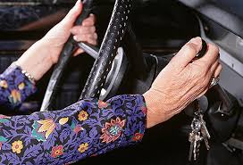
Fitness to Drive?

Slide 8
Can you calculate your taxes?

Slide 9
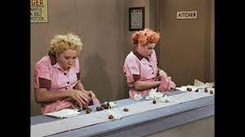
Can you work on an assembly line?

Slide 10
Can you perform surgery?

Slide 11
Cognitive and Mental Health Screening
Montreal Cognitive Assessment (MOCA) – a brief but challenging cognitive test out of 30 points
Everyday Cognition Scale (ECog) – an informant questionnaire focused on daily limitations
Hospital Anxiety and Depression Scale (HADS) – a brief questionnaire assessing anxiety and depression for use in individuals with physical debility
Generalized Anxiety Disorder 7 (GAD-7) – a brief measure of general anxiety
PTSD Checklist (PCL) – a brief measure of PTSD symptoms

Slide 12
Common Mental Health Concerns
Anxiety
Depression
OCD
PTSD

Slide 13
Psychotherapy for Long Covid (1)
Treatment of choice is Acceptance and Commitment Therapy (ACT)
6 Pillars of ACT
Acceptance
Cognitive Defusion
Contact with the Present Moment
Values
Committed Action
Self-As Context

Slide 14
Psychotherapy for Long Covid (2)
Other helpful psychotherapeutic approaches:
Psychodynamic Psychotherapy – effective in helping patients understand why they are “making sense” of their Long Covid in the manner that they are
Family Systems – effective in underscoring that chronic illness is not merely an individual problem but in key respects a family problem
Cognitive Therapy – effective in helping people challenge maladaptive thoughts and distorted kinds of thinking

Slide 15
Acceptance Acrostic
A – Acknowledge that your situation may never meaningfully change even though you might desperately want it to.
C – Cut ties with a highly idealized view of the past that makes your current situation seem dire and unacceptable by comparison.
C – Cultivate an expansive and flexible view of the world and a view of yourself that allows for the presence of difficult and unwanted things.
E – Embrace things as they are – not as you want them to be.
P – Pray for grace as you work to learn how to treat yourself with kindness.
T – Try to remember that the struggles that you feel are often temporary and time-limited – that though they seem terrifying and real in the moment, they are usually fleeting if you can choose not to overly attend to them and give them power.
A – As you are able, choose to be vulnerable with others – as people embrace you in all of your glorious “mess,” you will learn to embrace yourself as well.
N – Normalize your struggles.
C – Create a vision for a rich life that can co-exist with difficulties of various kinds, reminding yourself that your life can be full right now – that having a life of wholeness and satisfaction is not contingent on the absences of challenges.
E – Explore the world around you and realize that you are not alone in your struggles – that there are people you love and respect and aspire to be like who are suffering too

Slide 16
Cognitive Complaints
Forgetting names
General word finding problems
Disinhibition – saying or doing things that reflect poor judgment, that are uncharacteristic historically
Problems processing information rapidly
Difficulties multi-tasking and set shifting
Generally feeling “foggy” and experiencing a decreased sense of mental clarity

Slide 17
Cognitive Domains Impacted
Attention
Executive Functioning
Memory – Amnestic deficits are rare
Processing Speed

Slide 18
Don't think "brain fog" - think "brain injury"

Slide 19
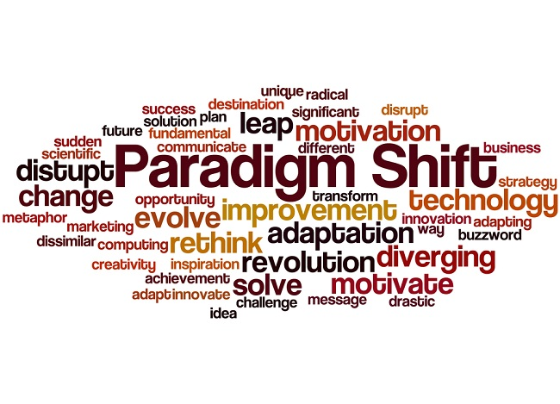

Slide 20
Cognitive Rehabilitation
Delivered by an occupational therapist or an SLP
Relies on compensatory strategies which lead to better functional cognition
Goal Management Training (GMT)

Slide 21
“I don’t need cognitive rehabilitation – my plan is just to hire a full time, 24/7, personal assistant.”
Anonymous Patient

Slide 22
The Impact of Impairment Varies Drastically
Impairment during a developmental trajectory vs in older age.
Impairment in individuals working in cognitively demanding jobs vs. jobs that are simple and repetitive.
Impairment in people in individualist vs. collectivist cultures.

Slide 23
You can do hard things

