Slide 1
Using a Health Equity Lens to Provide Behavioral Health Care
Eboni Winford, PhD, MPH
Licensed Psychologist

Slide 2
Disclosures
I have no relevant relationships to disclose.

Slide 3
Overview
This 1.5-hour webinar will provide an overview of health equity approaches to wellness. Specific strategies to help psychologists identify and address the inequities that clients/patients experience will be discussed. Through didactics and interactive conversation, participants will work to identify ways to apply a health equity lens to identifying and removing barriers to client/patient progress.

Slide 4
Learning Objectives
Define
Identify
Describe
health equity, health disparities, and differentiate these concepts from equality and social determinants of health.
three health disparities that negatively impact the psychological health of Knoxville's patients/clients
three ways that psychologists can address health disparities in therapeutic work

Slide 5
Case Example

Slide 6
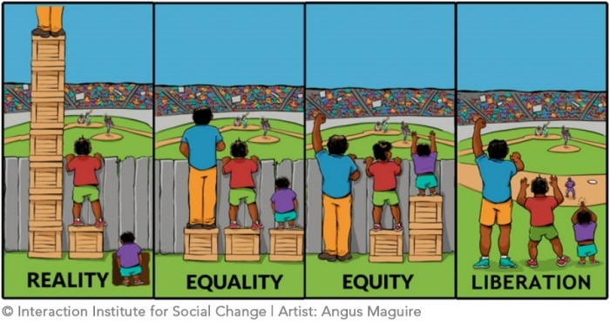

Slide 8
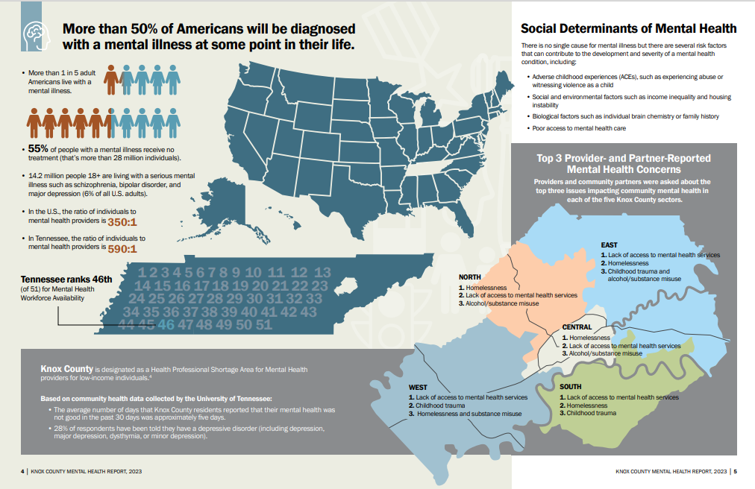

Slide 9
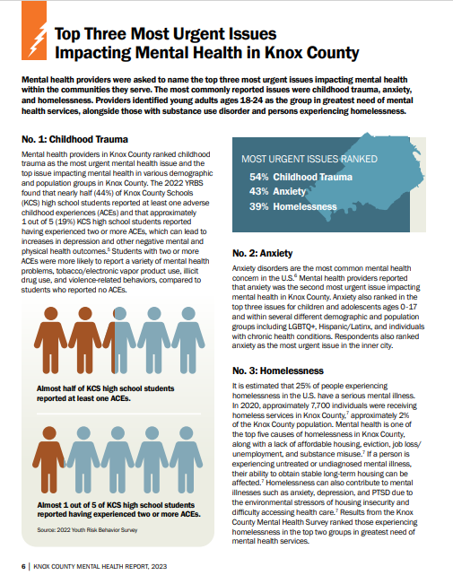
What are the Biggest Concerns?
Childhood trauma
Anxiety
Homelessness

Slide 10
What Are Your Clients’ Greatest Clinical Concerns?

Slide 11
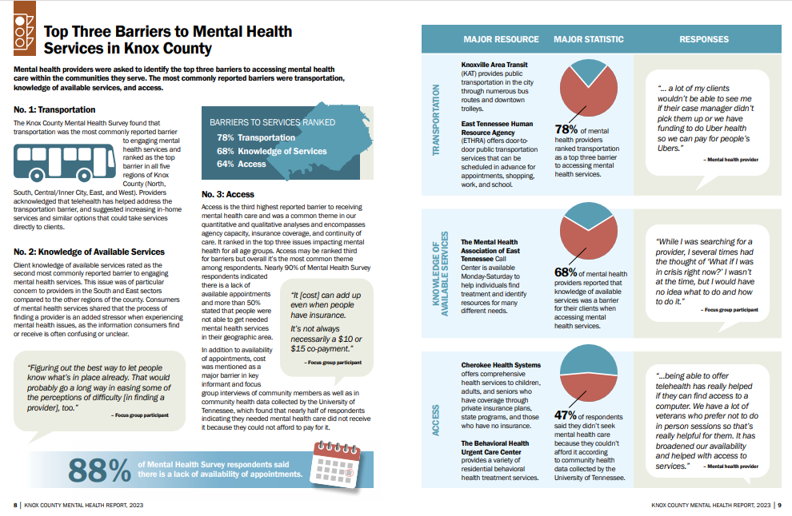

Slide 12
What Are Your Clients’ Greatest Barriers to Engaging in Care?

Slide 13
Equitable Care?
Manualized Treatments
Expertise
For whom were most of our manualized or other evidence-based interventions designed?
What counts as expertise in the therapy room?
Scheduling
Costs
Weekly, forever and ever until they die or you die?
Who gets to access therapy?
Using a Health Equity Lens

Slide 14
Equitable Care?
Location
Language
Who can access your services? In person? Electronically?
What steps are taken to include those whose first language may not be English?
Representation
Policies
Are staff members representative of the individuals receiving therapeutic services?
Late arrivals? No-shows? “Non-compliance?”

Slide 15
What Other Fence Posts Exist?

Slide 17
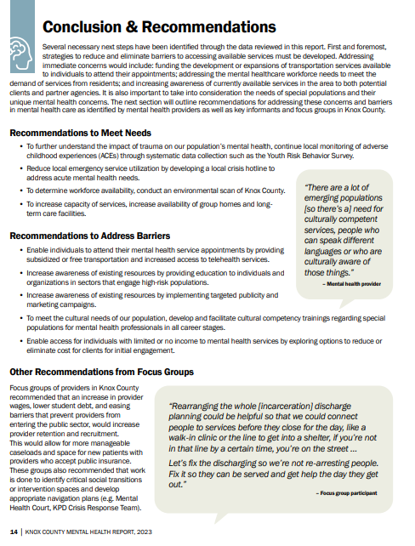
What Do We Do About It?

Slide 18
What Can You Do to Kick Down Fence Posts?

Slide 19
Case Example Revisited

Slide 20
References
Knox County Mental Health Report, 2023
Social Determinants of Health, 2018
Akhavan, S., & Tillgren, P. (2015). Client/patient perceptions of achieving equity in primary health care: A mixed methods study. International Journal for Equity in Health, 14(65), 1-12.
APA Council of Representatives. (2021, October). Advancing health equity in psychology: Resolution adopted by the APA Council of Representatives on October 29, 2021. Retrieved from https://www.apa.org/about/policy/advancing-health-equity-psychology
Findling, M. G., Zephyrin, L., Bleich, S. N., Tosin-Oni, M., Benson, J. M., & Blendon, R. J. (2022). Does racism impact healthcare quality? Perspectives of Black and Hispanic/Latino patients. Healthcare, 10(2), 1-3.
Kelly, J. F. (2022). Building a more equitable society: Psychology’s role in achieving health equity. American Psychologist, 77(5), 633-645.
McGregor, B., Belton, A., Henry, T. L., Wrenn, G., & Holden, K. B. (2019). Improving behavioral health equity through cultural competence training of health care providers. Ethnicity & Disease, 29(Suppl. 2), 359-364.
Peterson, A., Charles, V., Yeung, D., & Coyle, K. (2021). The health equity framework: A science-and justice-based model for public health researchers and practitioners. Health Promotion Practice, 22(6), 741-746.
Trambling, R. R. (2022). Are barriers to psychotherapy treatment seeking indicators of social determinants of health?: A critical review of the literature. The American Journal of Family Therapy, 50(5), 443-458.

Slide 21
Thank you
My contact info:

